Slide 1
Internet of Things used in a wider urban context
By Usman Basharat

Slide 2
WHAT IS INTERNET OF THINGS?
Internet of Things (IoT) is a physical object that contains an internet-based system that can be controlled remotely. International Data Corporation is a telecommunication organisation that does an analysis on technology globally.
"The Internet of Things will give IT managers a lot to think about," said Vernon Turner, Senior Vice President of Research. "Enterprises will have to address every IT discipline to effectively balance the deluge of data from devices that are connected to the corporate network. In addition, IoT will drive tough organizational structure changes in companies to allow innovation to be transparent to everyone, while creating new competitive business models and products."

Slide 3
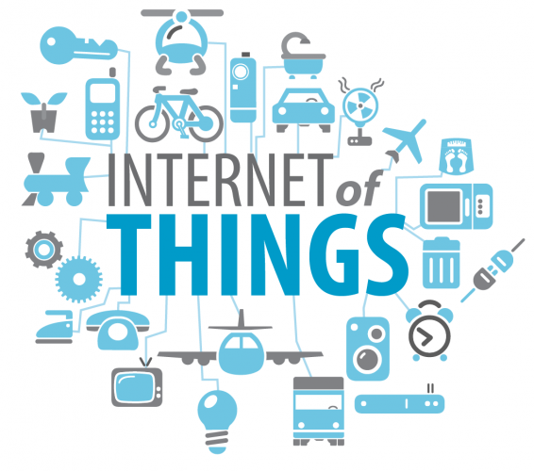
ADVANTAGES
COST EFFECTIVE
EXPANDING OF TECHNOLOGY
COST
TIME

Slide 4
disadvantages
SECURITY ISSUES
DATA PROTECTION ACT
COMPLEXITY
USERS
SIDE EFFECTS USAGE HOURS SPENT ON TECHNOLOGY
ADDICTION

Slide 5
Sensors, cloud computing and devices
Sensors are cheap.
A figure of trillion nodes of sensors would be used within our environment
Internet of things would rely on the sensors
Cloud services are going to be run to store the data.

Slide 6
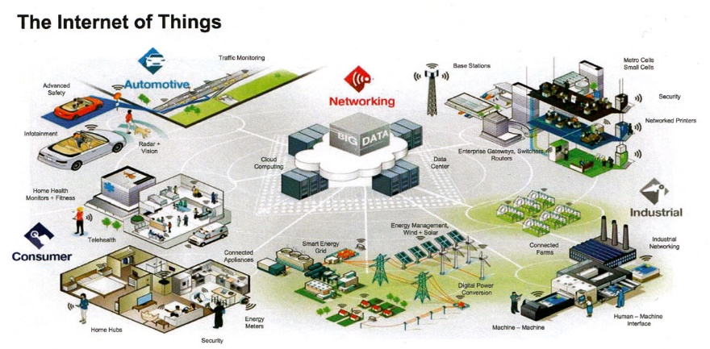
devices

Slide 7
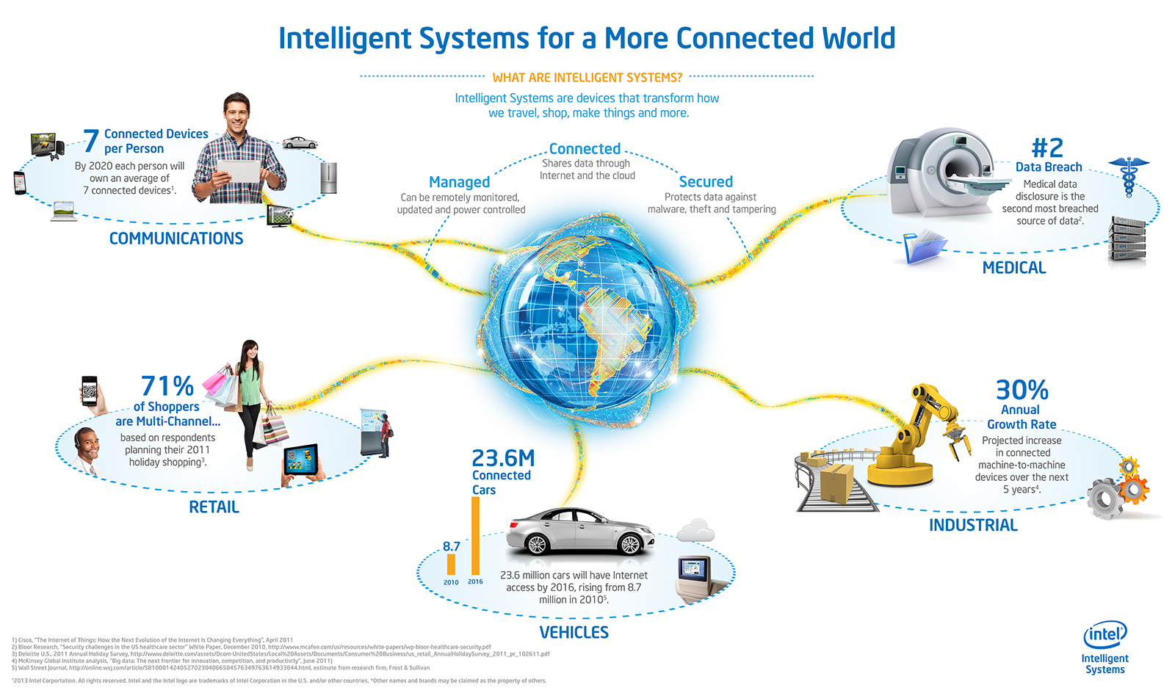
28 billion devices are expected
7.3 billion population in 2015

Slide 8
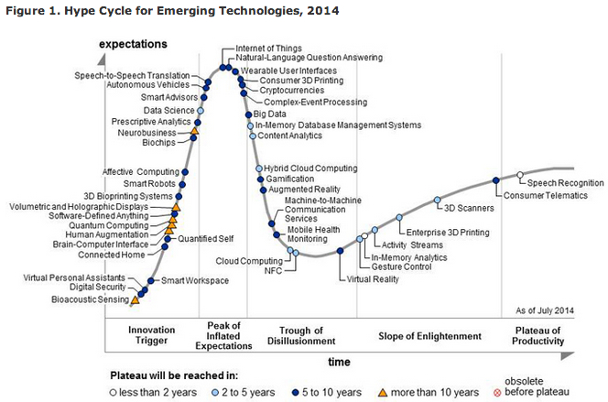
TIMELINE

Slide 9
ANY QUESTIONS?

Slide 10
REFERENCES
Image (2015) Expectation, [online] Available at: http://blogs-images.forbes.com/gilpress/files/2014/09/gartner_2014-2.jpg (Accessed 26 November 2015).
Image (2015) Internet of Things needs, [online] Available at: http://teamarin.net/wp-content/uploads/2013/08/Internet-of-Things-Needs-IPv6-566x500.png (Accessed 26 November 2015).
Image (2015) Internet of Things overview, [online] Available at: http://regmedia.co.uk/2014/05/06/freescale_internet_of_things_overview_1.jpg (Accessed 26 November 2015).
Follett, J. (n.d.) Designing for emerging technologies,.
www.idc.com, (2015) IDC Reveals Worldwide Internet of Things Predictions for 2015, [online] Available at: http://www.idc.com/getdoc.jsp?containerId=prUS25291514 (Accessed 26 November 2015).

